Slide 1
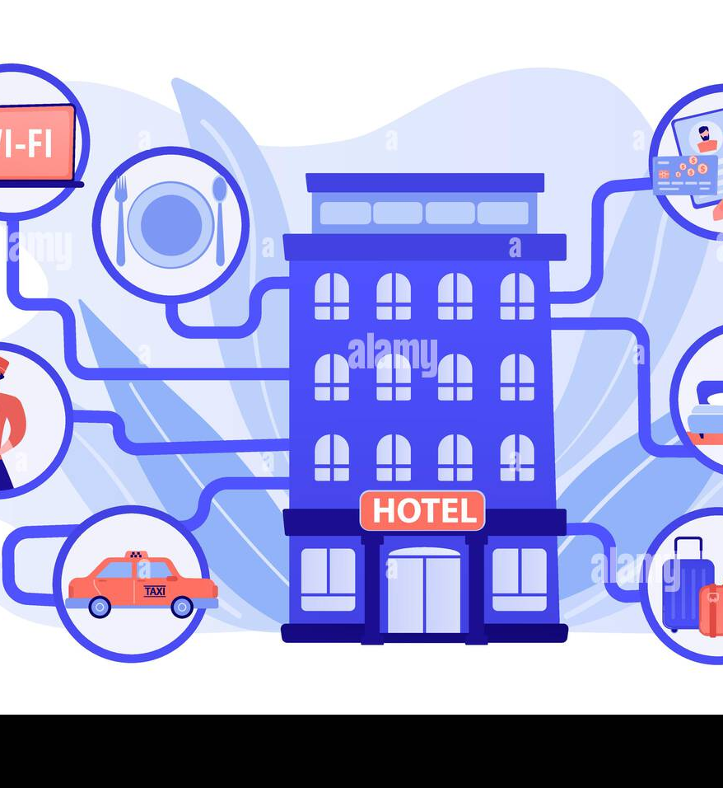
Tourism & hospitality management system
The Tourist & Hospitality Management System is a comprehensive web-based application designed to streamline the management of tourist accommodations, services, and activities.

Slide 2
Team members
Rajashree Satapathy - 2200031430
Y.Meenakshi – 2200032487
J.Bhavya – 2200032254

Slide 3
contents
Problem Statement
Abstract
Survey Report
Potential Users
Project Modules
Technical Skills required
Conclusions

Slide 4

Problem statement
The Tourist & Hospitality Management System is a comprehensive web-based application designed to streamline the management of tourist accommodations, services, and activities. It serves as a centralized platform where tourists can explore available accommodations, book rooms, and access information about local attractions and services. Additionally, hospitality providers can manage their offerings and reservations through the system. The platform aims to enhance the overall tourist experience and facilitate efficient management for hospitality businesses.

Slide 5

abstract
Our Tourism & Hospitality Management System is a powerful software solution tailored to meet the unique needs of businesses in the travel and hospitality industry.
This integrated system optimizes key aspects of operations, including reservations, guest services, staff management, and financial tracking.
With user-friendly features and real-time insights, our system ensures efficiency, enhances guest satisfaction, and contributes to overall business success.

Slide 6

Survey report

Slide 7
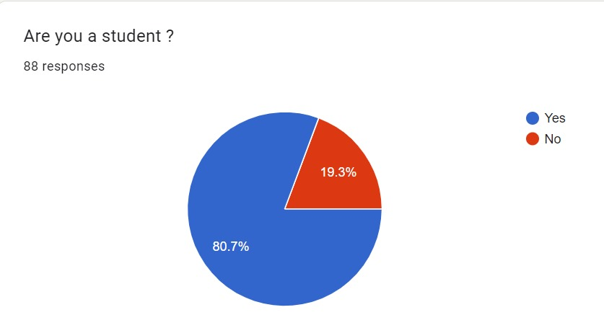

Slide 8
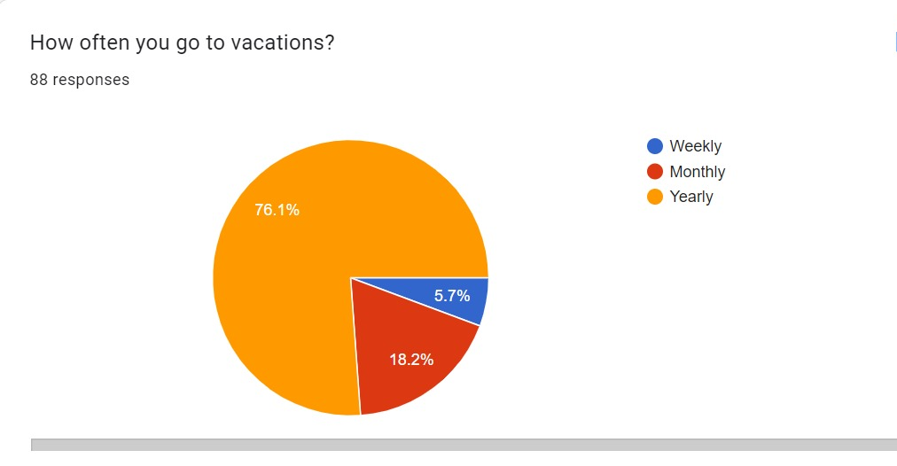

Slide 9
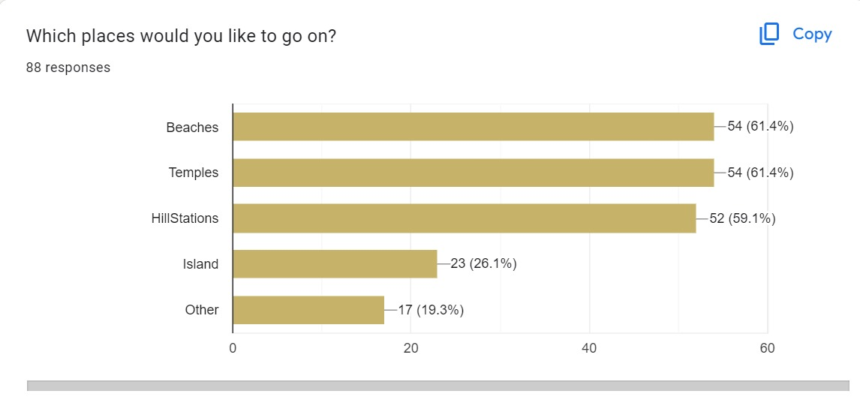

Slide 10
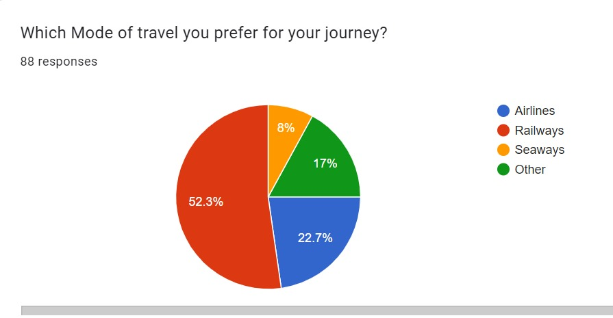

Slide 11
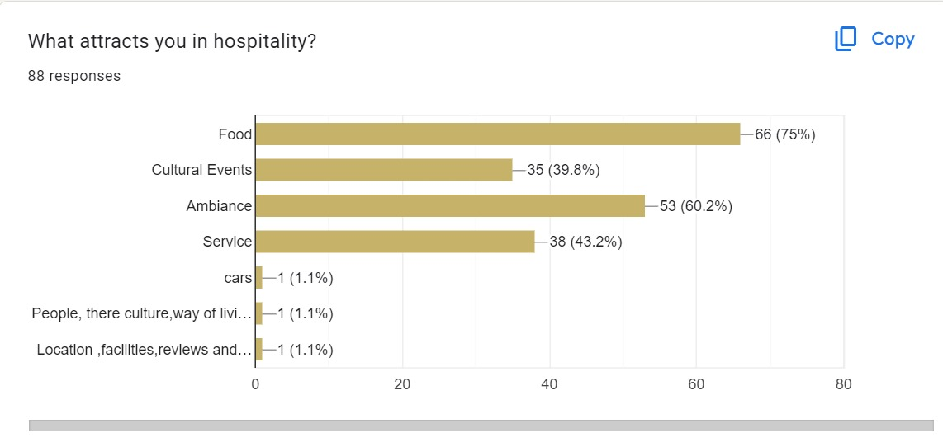

Slide 12

Potential users
Tourist Guides
Travel Agencies
Common people
Companies

Slide 13

Project modules
Administrator module
Hotel Module
Transportation Module
Package Modules
Testimonials module
Routes module

Slide 14

Technical skills required
Python Programming
Django Framework
Front-End Technologies: HTML, CSS, and JavaScript.
Database Knowledge: Understanding of relational databases and Django's ORM.
Web Security
Testing: Familiarity with testing frameworks.
Web Server Deployment: Knowledge of deploying Django applications.

Slide 15

conclusion
In conclusion, a tourism & hospitality management system is a valuable tool for the tourism and hospitality industry, as it can enhance the quality, efficiency, and profitability of the services offered. However, developing such a system requires careful consideration of the needs and expectations of the various stakeholders involved, as well as the adoption of the appropriate technologies to enable the system to be scalable, secure, intelligent, and innovative. A tourism & hospitality management system can be a competitive advantage for the industry, as it can provide better customer satisfaction, loyalty, and retention.

Slide 16


